Slide 1
Enhancing Financial Decision- Making: The Role of the FinTalk Predictive Assistant

Slide 2

Many investors struggle with: Accessing Real-Time Data: Keeping track of up-to-date stock prices and financial information. Understanding Complex Analysis: Interpreting financial metrics and trends can be challenging without specialized tools. Making Predictions: Forecasting future stock performance is often difficult without advanced analytical tools. Difficulty in Trend Identification: Identifying and interpreting long-term market trends and patterns can be challenging without advanced analytical tools.

Slide 3
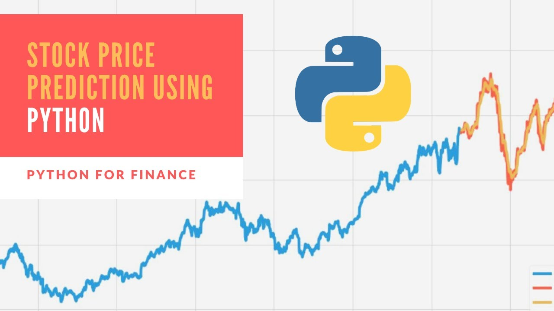
The FinTalk Predictive Assistant aims to solve these problems by: Providing Real-Time Stock Information: Offering current stock prices and data through an easy-to-use chatbot. Simplifying Financial Analysis: Helping users understand and analyze financial data and trends through natural conversation. Predicting Future Trends: Using advanced models to forecast stock prices and trends, assisting users in making informed investment decisions. Keeping Up with Financial News :The FinTalk Predictive Assistant provides summarized news and explains how recent events might impact specific stocks, making it easier for investors to stay informed.

Slide 4
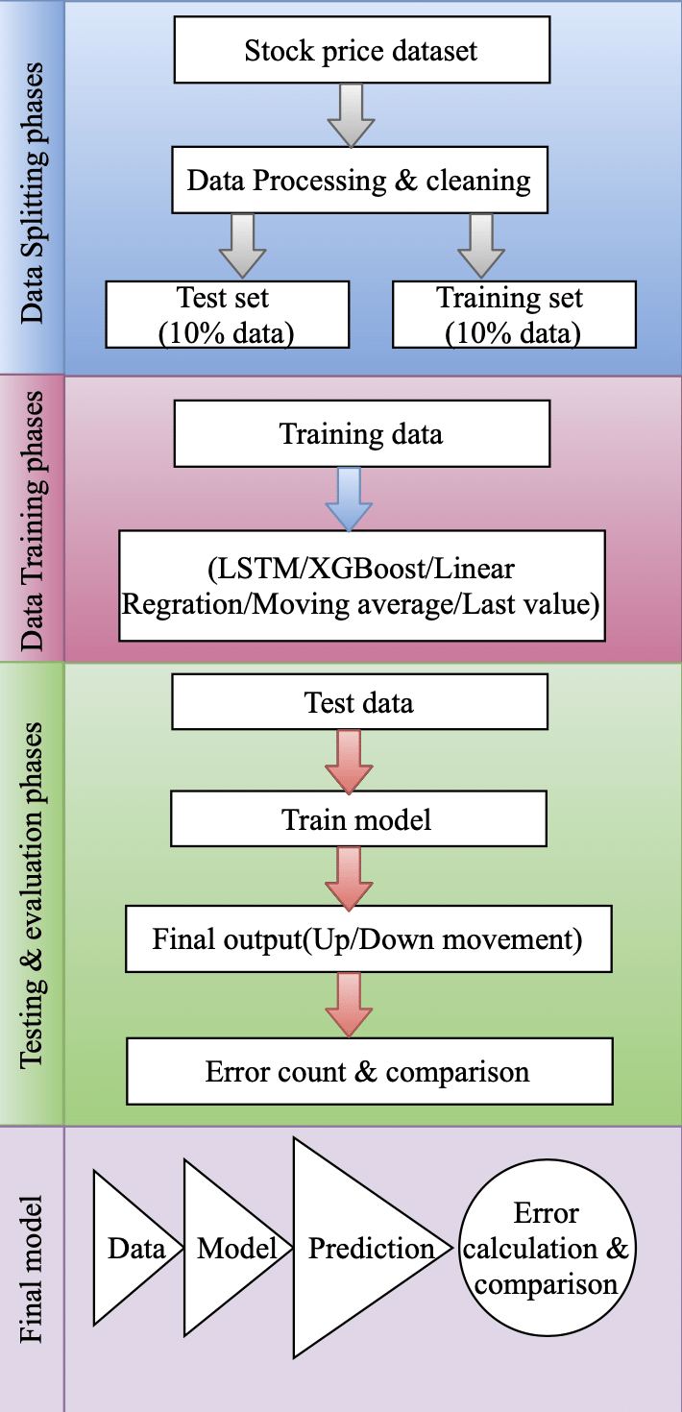
The FinTalk Predictive Assistant aims to solve these problems by: Providing Real-Time Stock Information: Offering current stock prices and data through an easy-to-use chatbot. Simplifying Financial Analysis: Helping users understand and analyze financial data and trends through natural conversation. Predicting Future Trends: Using advanced models to forecast stock prices and trends, assisting users in making informed investment decisions. Keeping Up with Financial News :The FinTalk Predictive Assistant provides summarized news and explains how recent events might impact specific stocks, making it easier for investors to stay informed.

Slide 5
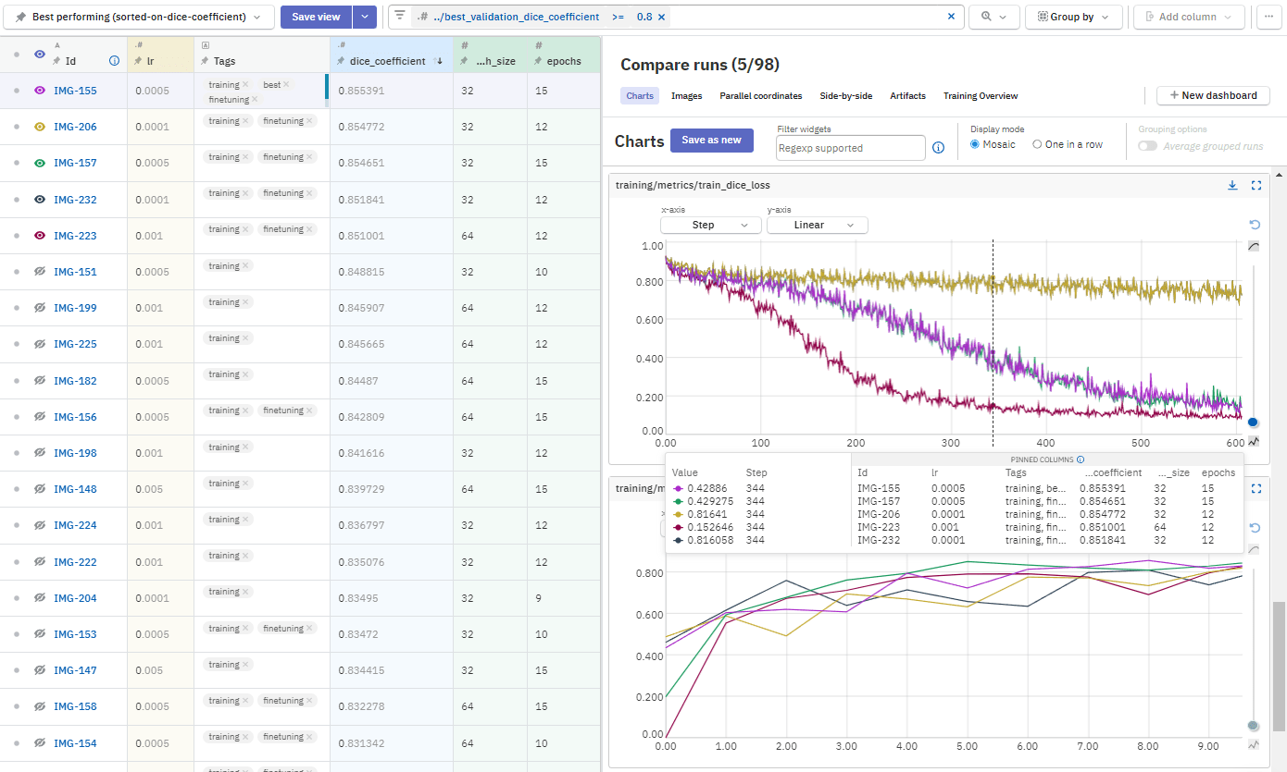

Libraries used in FinTalk Predictive Assistant:
Yfinance
Pandas
Numpy
Tensorflow
Matplotlib
Seaborn

